Slide 1
Capstone Engagement
Assessment, Analysis, and Hardening of a Vulnerable System

Slide 2
Table of Contents
This document contains the following sections:
01
Network Topology
02
Red Team: Security Assessment
03
Blue Team: Log Analysis and Attack Characterization
Hardening: Proposed Alarms and Mitigation Strategies
04

Slide 3
Network Topology
‹#›

Slide 4
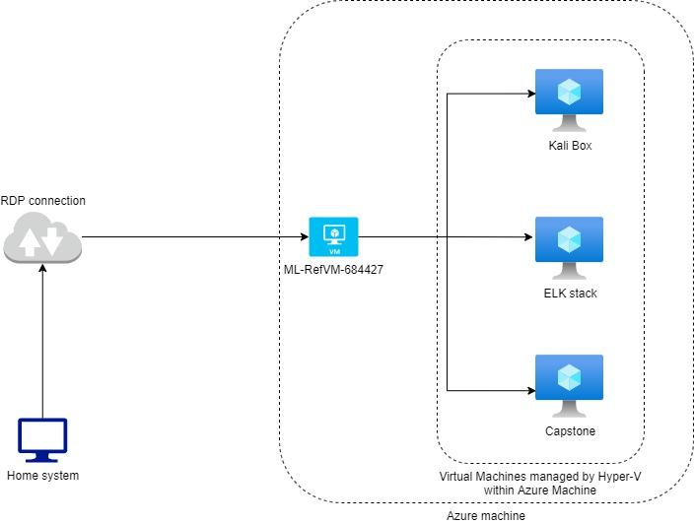
Network Topology
Network
Address Range:192.168.1.0/24
Netmask:255.255.255.0
Gateway:192.168.1.1
Machines
IPv4:192.168.1.105
OS:Linux (Ubuntu)
Hostname:Capstone
IPv4:192.168.1.90
OS:Linux (Kali)
Hostname:Kali
IPv4:192.168.1.100
OS:Linux (Ubuntu)
Hostname:ELK
IPv4:192.168.1.1
OS:Windows 10
Hostname:ML-RefVm-684427

Slide 5

Red Team
Security Assessment
‹#›

Slide 6
Recon: Describing the Target
Nmap identified the following hosts on the network:
Hostname | IP Address | Role on Network
Capstone | 192.168.1.105 | Web server
ELK | 192.168.1.100 | SIEM system
Kali | 192.168.1.90 | Penetration testing system
ML-RefVM-684427 | 192.168.1.1 | Switch/ Hyper-V manager

Slide 7
Vulnerability Assessment
The assessment uncovered the following critical vulnerabilities in the target:
Vulnerability | Description | Impact
Directory Listing is enabled for web server | Anyone can view all the files and directories on the web site, giving an attacker information that they shouldn’t have | Due to this being enabled, an attacker can access the company sales documents, and the secret folder with information about how to access the webdav.
Open Source Intelligence | There is too much information on the website about a secret folder section, and who is in charge of it. | This allows an attacker to easily identify a potential username for someone managing a section that they should not know about.
Weak passwords and no account lockout | Users have weak passwords and no account lockout has been enabled for repeated failed login attempts | Passwords are easily and quickly brute-forced
Unregulated access to secure sections of the web server | Any IP address can access the secure sections of the web server | Any IP can gain access to the secure sections of the web server

Slide 8
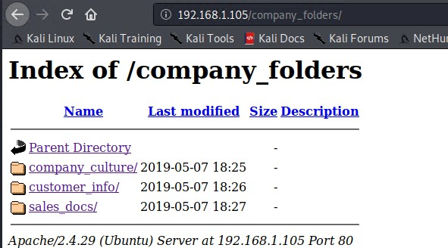
Exploitation: Directory Listing is enabled on the web server
01
02
03
Tools & Processes
Navigating to http://192.168.1.105 using a web browser.
Achievements
Information about all the files and directories that the web server has available

Slide 9
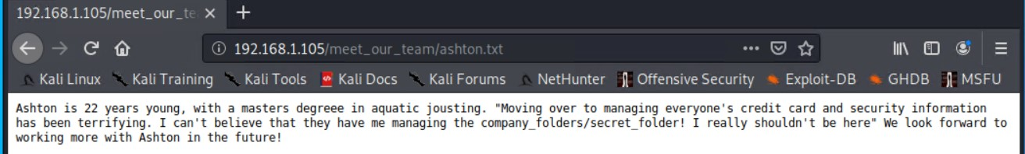
Exploitation: Open Source Intelligence
01
02
03
Tools & Processes
Navigating around the website, there is a continuous mention of a secret folder section. Along with who manages that section.
Achievements
Gives direction for a potential username to try for access to a section of the web server that is password protected.

Slide 10
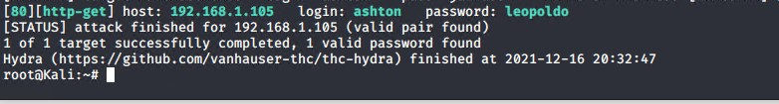
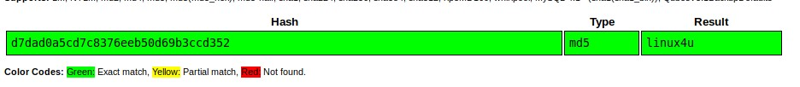
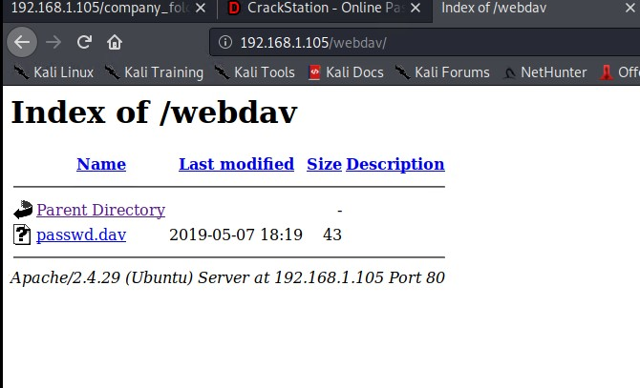
Exploitation: Weak passwords and no account lockout
01
02
03
Tools & Processes
Using Hydra and Crackstation.com, able to easily and quickly figure out the different passwords for the usernames
Achievements
Access to both the secret folder on the web server, and access to the webdav portion of the web server as well

Slide 11

Blue Team
Log Analysis and Attack Characterization
‹#›

Slide 12
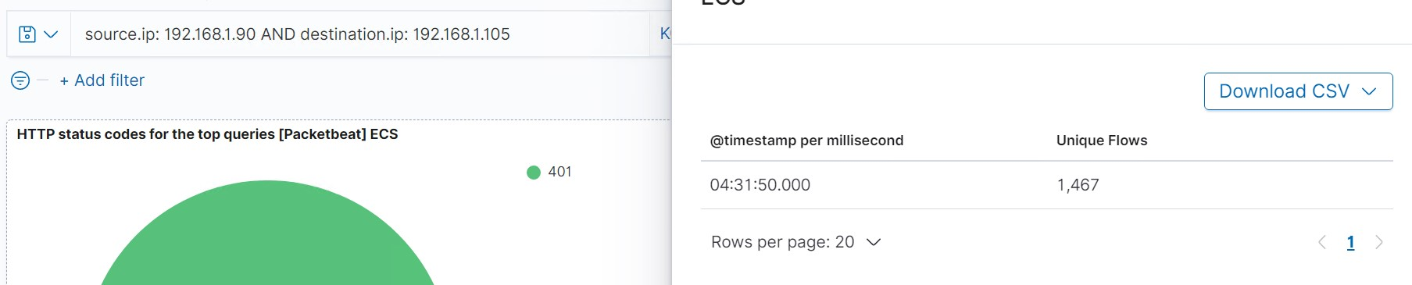
Analysis: Identifying the Port Scan
The port scan occurred on Dec 17, 2021 at 04:31:50
1,467 packets were sent from the Kali system to the Capstone system
The massive number of connections/flows in such a short time period all from the same IP address but to multiple different ports

Slide 13
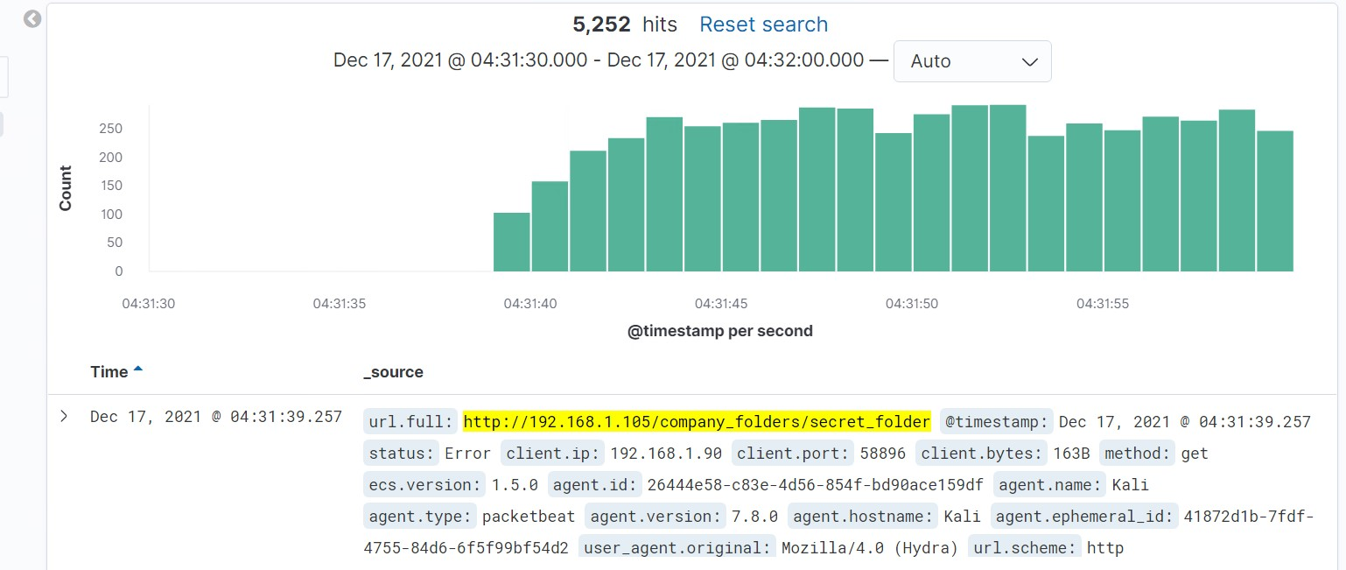
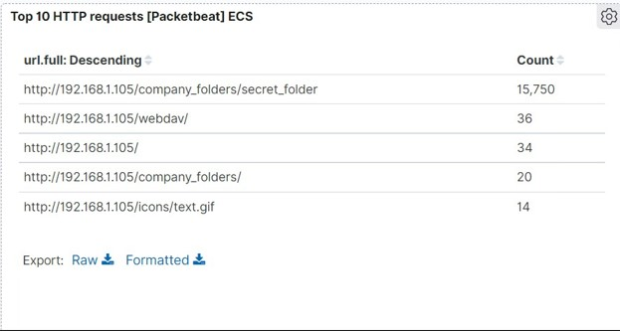
Analysis: Finding the Request for the Hidden Directory
The initial request for the secret_folder was on Dec 17, 4:31:39, a total of 15750 requests were made to that folder during the attack.
Once access was achieved the attacker viewed the only file in that folder ‘connect_to_corp_server’. This file contained directions for how to connect to the server, along with a username and easily crackable password hash.

Slide 14
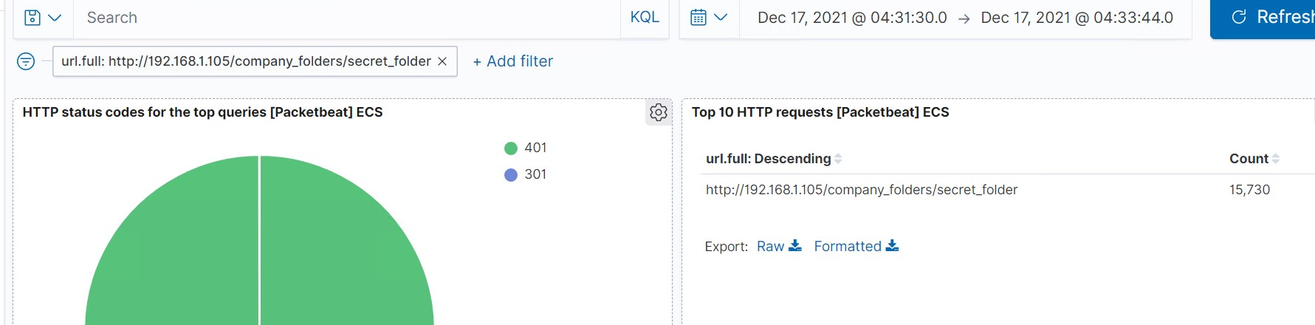
Analysis: Uncovering the Brute Force Attack
The attacker made 15,730 attempts to brute force the password before it was discovered.

Slide 15
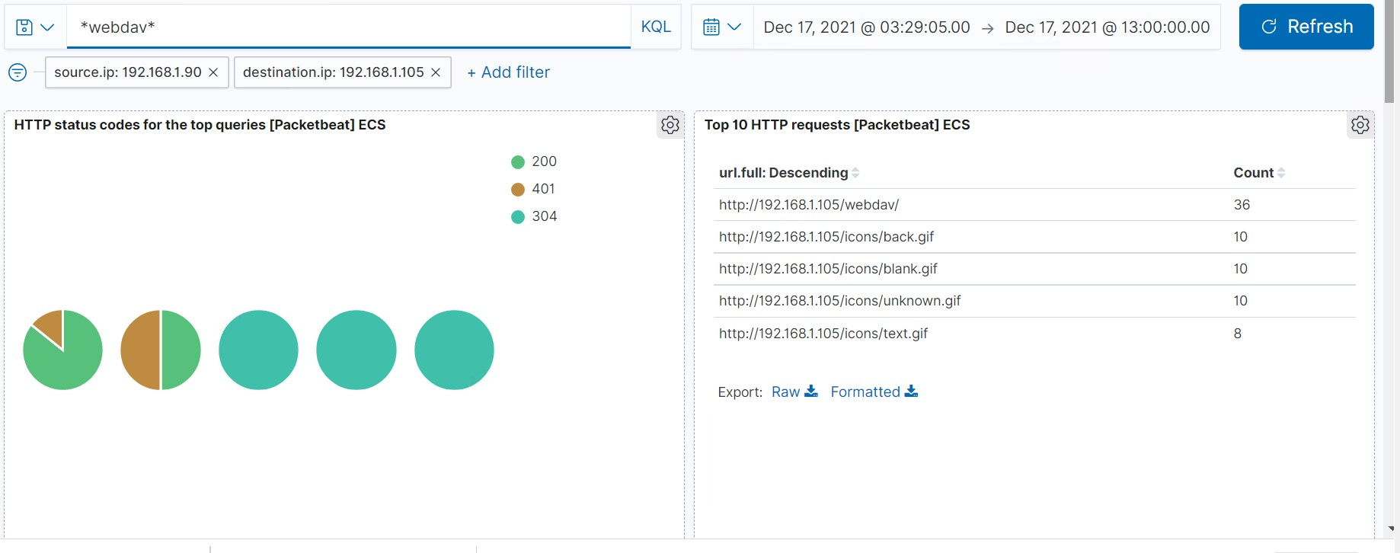
Analysis: Finding the WebDAV Connection
There were 36 requests made to the webdav account during the time of the attack.
The attacker requested the passwd.dav, test.txt, and open_this_please.php files, 2 of which the attacker uploaded to the webdav directory.

Slide 16
Blue Team
Proposed Alarms and Mitigation Strategies
‹#›

Slide 17
Mitigation: Blocking the Port Scan
An alarm that triggers after a certain number of TCP connections to different ports from the same IP address in a specified amount of time. You could also link in the size of the packets since the standard size of nmap scans is 58 bytes. A good threshold for the alarm would be 5 connections in 30 seconds.
Installing and configuring a firewall to return all packets with a size of 58 bytes with a RST connection. You can also disable the ICMP echo and echo-reply.

Slide 18
Mitigation: Finding the Request for the Hidden Directory
Removing any mention of the secret folder from the public facing sections of the website would be a good start.
Setting up a public key so that only specific systems are allowed to access the hidden directory as well.
In an open terminal type
Ssh-keygen -t rsa
Tell it where to save the key
Enter a passphrase
Make sure the server has a copy of the publickey
An alarm that triggers anytime the folder is accessed from an IP address other than those specified since it is supposed to contain proprietary company data.
If the company is going to continue to have proprietary data in the directory then you would set the alarm to go off anytime the directory is accessed from an unknown IP address.

Slide 19
Mitigation: Preventing Brute Force Attacks
An alarm that triggers after a specified number of failed login attempts. The alarm could have the firewall block that IP address for 1 hr, or it could block that username for 1 hr.
If the company is not expected to grow quickly in the next few months setting the alarm to trigger after 5 failed login attempts within 30 minutes would be a good starting point.
Again configuring the firewall to block IP addresses and setting up a public key would be 2 ways to prevent a brute force attack from successfully occuring.
There are a few different programs that can also be used to do the same thing, but these two programs shouldn’t be used on the same system.
SSHguard sudo apt-get install sshguard
Fail2ban apt-get install fail2ban

Slide 20
Mitigation: Detecting the WebDAV Connection
An alarm that triggers anytime the folder is accessed from an IP address other than those specified since it is supposed to contain proprietary company data.
If the company is going to continue to have proprietary data in the directory then you would set the alarm to go off anytime the directory is accessed from an unknown IP address.
Disabling ports or changing the webdav connection from the default port to a port about 1024.
Setting up a public key so that only specific systems are allowed to access the hidden directory as well.
Ssh-keygen -t rsa
Tell it where to save the key
Enter a passphrase
Make sure the server has a copy of the publickey

Slide 21
Mitigation: Identifying Reverse Shell Uploads
Any time the HTTP request method PUT is used it should trigger an alarm.
Or if the webdav folder is still going to have files uploaded and downloaded, you could set up the trigger any time a certain file type is uploaded, and then block the IP address that uploaded it.
Only allowing certain file types to be uploaded.
Scanning the files for Malware.
Verifying the file type being uploaded, ie someone trying to upload a .exe as a .txt file.

